Slide 1

Machine Learning and Audio
Stephen McLaughlin
PhD Student

Slide 2
Stephen McLaughlin / @SteveMcLaugh
Notes:
http://gtspirit.com/2014/03/12/renault-caterham-sports-car-design-as-good-as-finished/

Slide 3
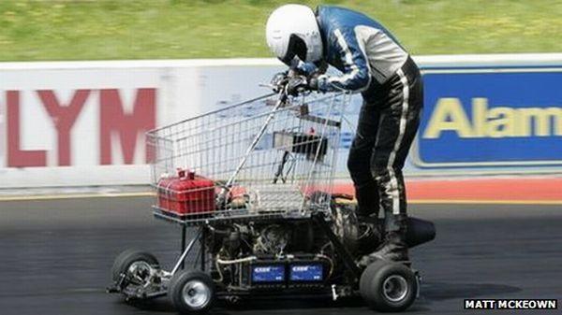
Stephen McLaughlin / @SteveMcLaugh
Notes:
https://www.youtube.com/watch?v=xz8_udPVdok
Fast, but not the easiest thing to handle — and it might be a bumpy ride

Slide 4
Stephen McLaughlin / @SteveMcLaugh
Notes:
This is not an option.

Slide 5
Types of machine learning
Regression
output: a number
Classification
output: a class (i.e., category)
Stephen McLaughlin / @SteveMcLaugh
Notes:
#metadatagoals

Slide 6
Types of machine learning
Supervised learning
starting with labeled training data
Unsupervised learning
inferring relationships without class labels
Reinforcement learning
neural networks
Stephen McLaughlin / @SteveMcLaugh
Notes:
#metadatagoals

Slide 7
Disciplines in audio ML
Music information retrieval (MIR)
audio fingerprinting (Shazam)
automatic transcription
audio thumbnailing
Speech to text
Speaker recognition
speaker identification
speaker verification
Stephen McLaughlin / @SteveMcLaugh
Notes:
#metadatagoals

Slide 8

Stephen McLaughlin / @SteveMcLaugh
Notes:
This is not an option.

Slide 9
Some key algorithms
Linear regression
numbers in, numbers out
Logistic regression
numbers and/or classes in, classes out
Stephen McLaughlin / @SteveMcLaugh
Notes:
#metadatagoals

Slide 10
Some key supervised learning algorithms
Linear regression
numbers in, numbers out
Logistic regression
numbers and/or classes in, classes out
Stephen McLaughlin / @SteveMcLaugh
Notes:
#metadatagoals

Slide 11
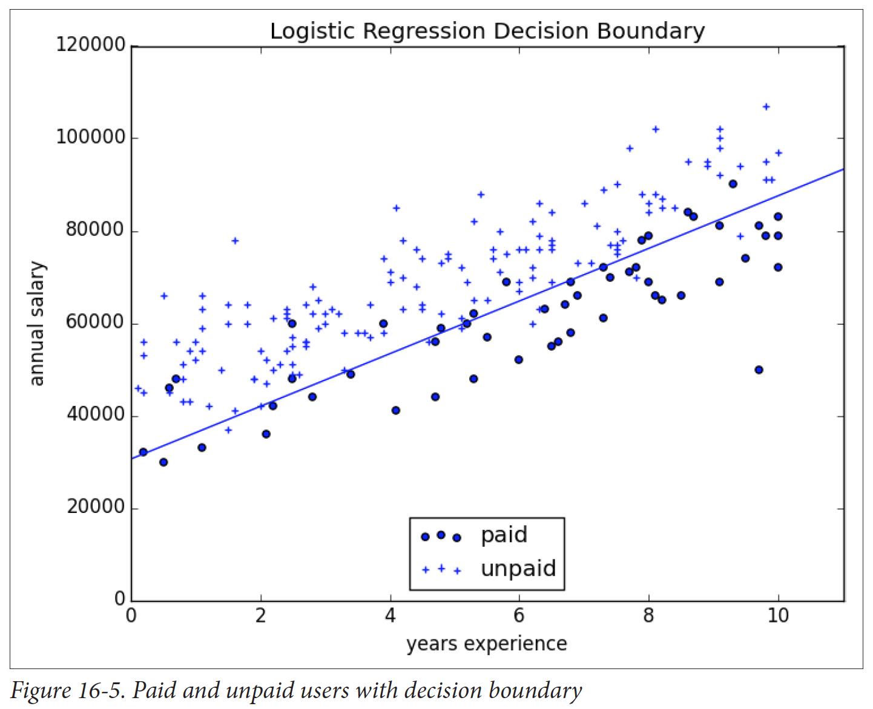
Logistic regression
prone to overfitting (training data not representative of real world)
Credit: Grus 2015
Stephen McLaughlin / @SteveMcLaugh
Notes:
Gradient boosting is a version of decision trees ... like they cut off the teee at some point?Both random forest and gradient boosting are optimization of decision trees

Slide 12
K nearest neighbor
the curse of dimensionality
intuitive, but not very efficient
Credit: Grus 2015
Stephen McLaughlin / @SteveMcLaugh
Notes:
#metadatagoals

Slide 13
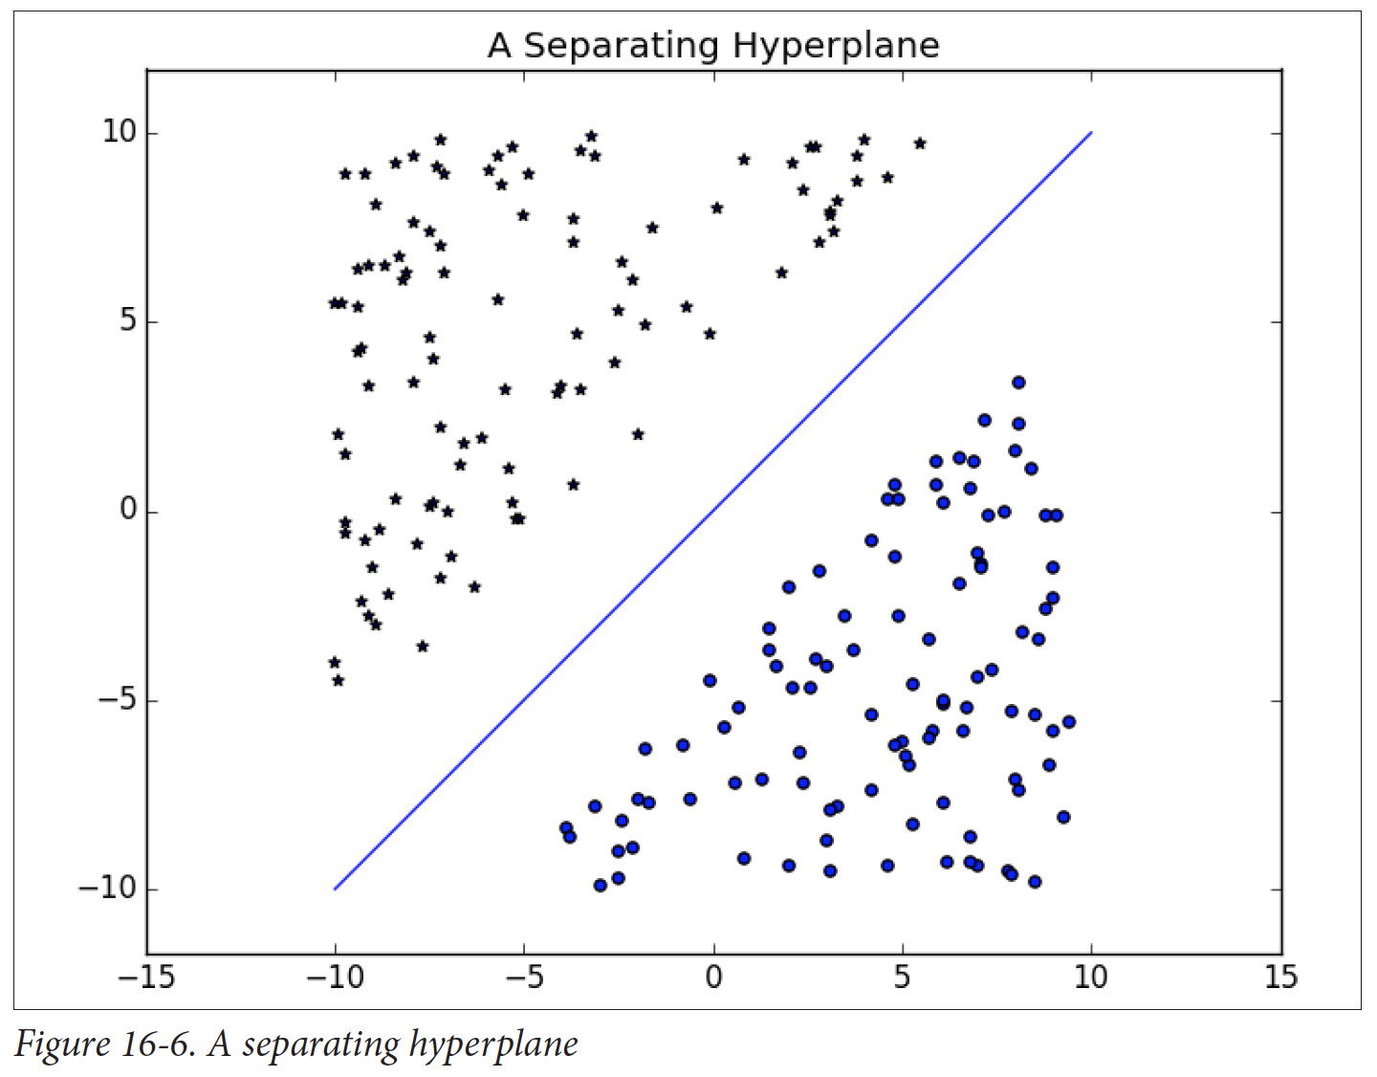
Support
vector
machine
(SVM)
Fast and cheap
Your #1 go-to
Credit: Grus 2015
Stephen McLaughlin / @SteveMcLaugh
Notes:
#metadatagoals

Slide 14
Decision
trees
Slower than SVMs
Highly interpretable results
Credit: Grus 2015
Stephen McLaughlin / @SteveMcLaugh
Notes:
#metadatagoals

Slide 15
Gaussian
mixture
models
OK with shades of gray
Well-suited for speaker identification
Credit: Yu Zhu
Stephen McLaughlin / @SteveMcLaugh
Notes:
#metadatagoals

Slide 16
Neural networks
“The future”
Output not interpretable
Slow, expensive, steep learning curve
Credit: Wikimedia Commons
Stephen McLaughlin / @SteveMcLaugh
Notes:
#metadatagoals

Slide 17
Types of machine learning
Supervised learning
starting with labeled training data
Unsupervised learning
inferring relationships without class labels
Reinforcement learning
neural networks
Stephen McLaughlin / @SteveMcLaugh
Notes:
#metadatagoals

Slide 18
Types of machine learning
Supervised learning
starting with labeled training data
Unsupervised learning
inferring relationships without class labels
Reinforcement learning
neural networks
Stephen McLaughlin / @SteveMcLaugh
Notes:
#metadatagoals

Slide 19
Types of machine learning
Supervised learning
starting with labeled training data
Unsupervised learning
inferring relationships without class labels
Reinforcement learning
neural networks
Stephen McLaughlin / @SteveMcLaugh
Notes:
#metadatagoals

Slide 20
Types of machine learning
Supervised learning
starting with labeled training data
Unsupervised learning
inferring relationships without class labels
Reinforcement learning
neural networks
Stephen McLaughlin / @SteveMcLaugh
Notes:
#metadatagoals

Slide 21
Credit: http://scikit-learn.org
Stephen McLaughlin / @SteveMcLaugh
Notes:
Gradient boosting is a version of decision trees ... like they cut off the teee at some point?Both random forest and gradient boosting are optimization of decision trees

Slide 22
Credit: http://scikit-learn.org
Stephen McLaughlin / @SteveMcLaugh
Notes:
SVM
"This is the idea behind the support vectormachine, which finds the hyperplane that maximizes the distance to the nearest pointin each class (Figure 16-6)."- data science from scratch

Slide 23
Credit: http://scikit-learn.org
Stephen McLaughlin / @SteveMcLaugh
Notes:
Gradient boosting is a version of decision trees ... like they cut off the teee at some point?Both random forest and gradient boosting are optimization of decision trees

Slide 24
Credit: http://scikit-learn.org
Stephen McLaughlin / @SteveMcLaugh
Notes:
SVM
"This is the idea behind the support vectormachine, which finds the hyperplane that maximizes the distance to the nearest pointin each class (Figure 16-6)."- data science from scratch

Slide 25
Credit: http://scikit-learn.org
Stephen McLaughlin / @SteveMcLaugh
Notes:
Gradient boosting is a version of decision trees ... like they cut off the teee at some point?Both random forest and gradient boosting are optimization of decision trees

Slide 26
General metadata goals
Segmentation by speaker
Segmentation by event structure
Stephen McLaughlin / @SteveMcLaugh
Notes:
#metadatagoals

Slide 27
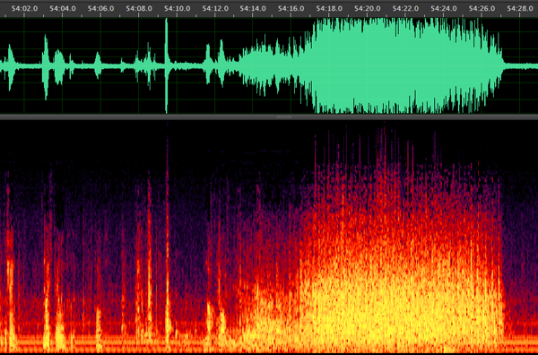
Reading by Charles Olson, Vancouver Poetry Conference, 1963
Stephen McLaughlin / @SteveMcLaugh

Slide 28
General metadata goals
Segmentation by speaker
Segmentation by event structure
High-level labels
Language
Genre
Topic/theme
Stephen McLaughlin / @SteveMcLaugh
Notes:
#metadatagoals

Slide 29
General metadata goals
Segmentation by speaker
Segmentation by event structure
High-level labels
Language
Genre
Topic/theme
Low-level labels
Notable passages
Material features/quirks
Stephen McLaughlin / @SteveMcLaugh
Notes:
#metadatagoals

Slide 30
General search goals
Acoustic fingerprint search (à la Shazam)
Stephen McLaughlin / @SteveMcLaugh
Notes:
The means to creating useful metadata as in the previous slide

Slide 31
General search goals
Acoustic fingerprint search (à la Shazam)
Locate speaker of interest
Stephen McLaughlin / @SteveMcLaugh
Notes:
The means to creating useful metadata as in the previous slide

Slide 32
General search goals
Acoustic fingerprint search (à la Shazam)
Locate speaker of interest
Locate sound classes of interest
Stephen McLaughlin / @SteveMcLaugh
Notes:
The means to creating useful metadata as in the previous slide

Slide 33
General search goals
Acoustic fingerprint search (à la Shazam)
Locate speaker of interest
Locate sound classes of interest
Full-text search
Stephen McLaughlin / @SteveMcLaugh
Notes:
The means to creating useful metadata as in the previous slide

Slide 34
Concrete PennSound goals
Expedite laborious segmentation work
Stephen McLaughlin / @SteveMcLaugh
Notes:
radio: eg, interviewed about another poet
Locate poems of interest – for non-segmented works

Slide 35
Concrete PennSound goals
Expedite laborious segmentation work
Assemble centralized metadata set
Stephen McLaughlin / @SteveMcLaugh
Notes:
radio: eg, interviewed about another poet
Locate poems of interest – for non-segmented works

Slide 36
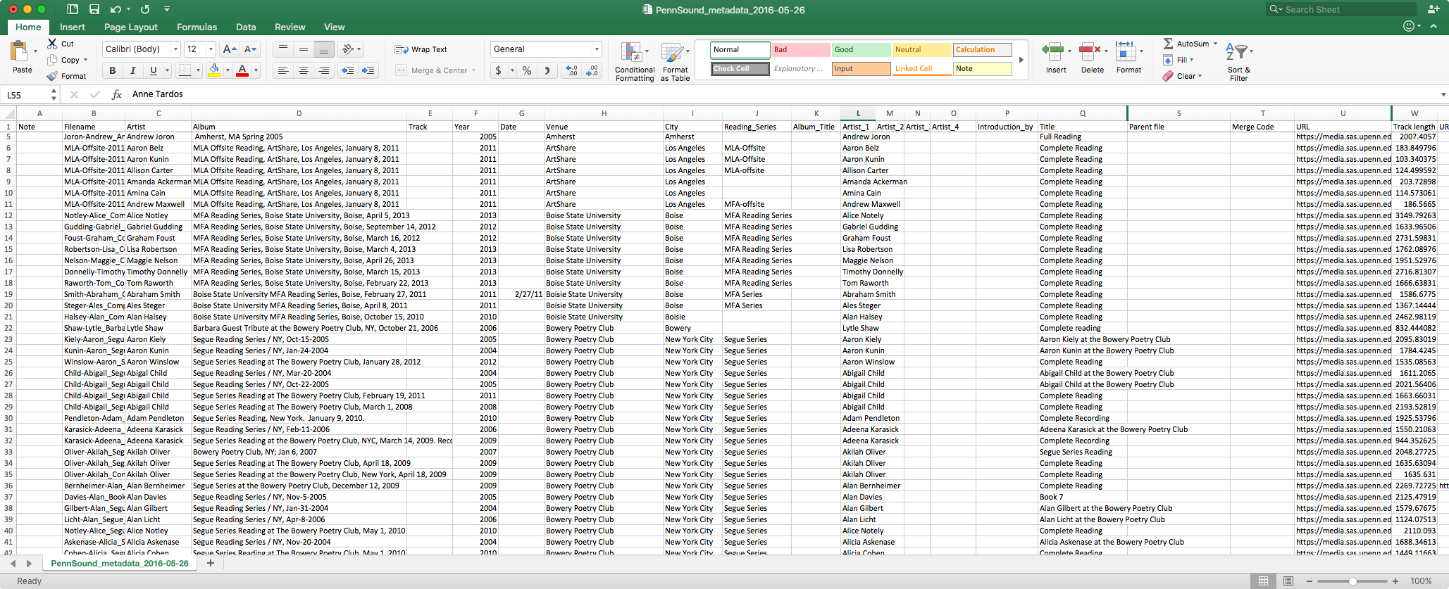
Stephen McLaughlin / @SteveMcLaugh

Slide 37
Concrete PennSound goals
Expedite laborious segmentation work
Assemble centralized metadata set
Locate poems of interest
Stephen McLaughlin / @SteveMcLaugh
Notes:
radio: eg, interviewed about another poet
Locate poems of interest – for non-segmented works

Slide 38
Concrete PennSound goals
Expedite laborious segmentation work
Assemble centralized metadata set
Locate poems of interest
Locate speakers of interest where metadata is scant
Q&A sessions
Panel discussions
Recorded seminars
Radio/TV/film appearances
Stephen McLaughlin / @SteveMcLaugh
Notes:
radio: eg, interviewed about another poet
Locate poems of interest – for non-segmented works

Slide 39
Approaches at hand
Event detection (silence, applause, etc.)
Speech to text
Unsupervised speaker diarization
Speaker recognition
Closed set: classification among pre-enrolled speakers
Open set: searching for given speaker(s) against universal background model (UBM)
Stephen McLaughlin / @SteveMcLaugh
Notes:
Crude event detection
open set = haystack search
Trained using universal background model (UBM)

Slide 40
Changes in the past 5 years
Processors are faster.
Storage is cheaper.
VPSes are friendlier.
More and better core ML tools.
More and better high-level wrappers.
GitHub and Stack Exchange are much larger.
Stephen McLaughlin / @SteveMcLaugh
Notes:
And I’m gonna be ... permit me to deal in straw men for a sec. This isn’t even polemical, it’s just a matter of fact.

Slide 41
Stack Goals
Free / open source software
Cost, scale, customization, transparency, stability, pedagogy, ideology
Stephen McLaughlin / @SteveMcLaugh
Notes:
Pedagogy: Students learn at home. And it’s harder than ever to find illicit copies of commercial software
Openness is political
ideology=political ideals and...
Last but not least: smug sense of superiority

Slide 42
Stack Goals
Free / open source software
Cost, scale, customization, transparency, stability, pedagogy, ideology
Avoid weird exchange formats. Aim for human and machine readability.
CSV > JSON > XML > DBs > Proprietary BLOBs
Stephen McLaughlin / @SteveMcLaugh
Notes:
Human(ist) readable
If you don’t need a tree, don’t use a tree
When you get really big, you do need databases. That’s no joke. But even in those cases, back everything up in flat files.

Slide 43
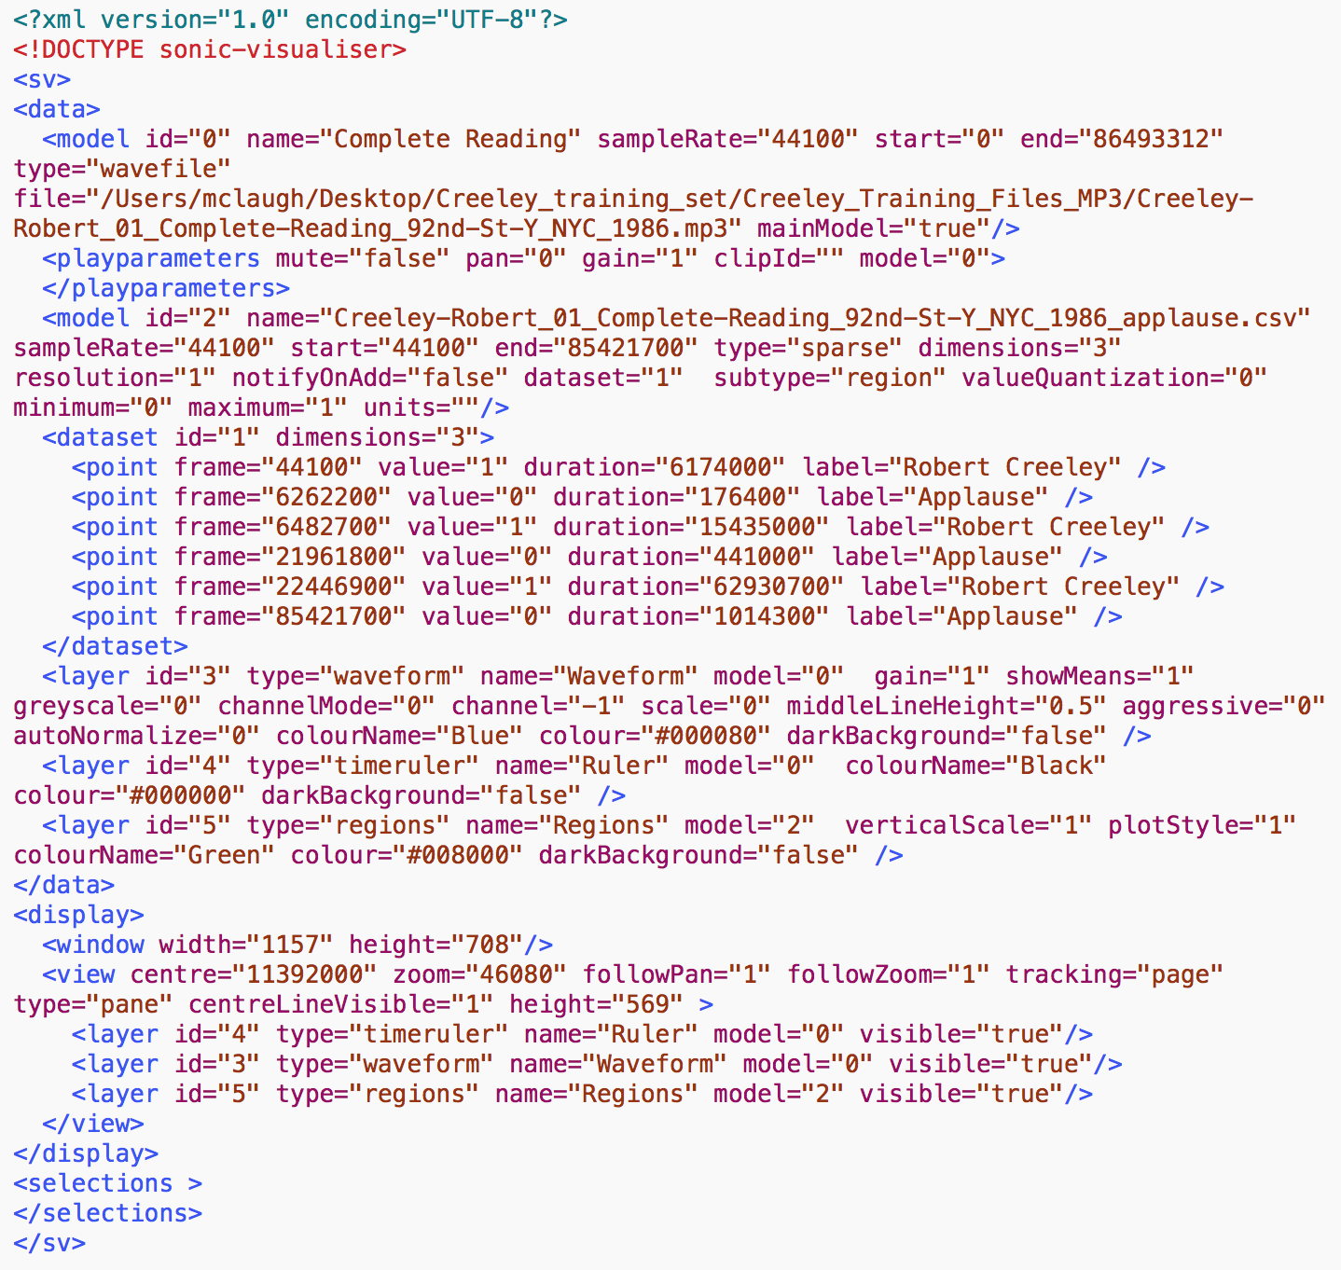
Sonic Visualiser
session file
Stephen McLaughlin / @SteveMcLaugh
Notes:
In the grand scheme, this is really refreshing. This is the whole session file — it has a hardcoded reference to the file’s pathname, totally transparent. But I take issue with the “frame” field ...
The sample rate is there, so one could check the timing later — but my real aim is to make this stuff friendly for humanists, who tend to be bad programmers — like me, by the way. I’m a bad programmer. I’m trying, but ... I’ll never be on the level of someone like Tony.
A lot of core GNU utilities have a –h option for human readability.
Be the -h you want to see in the world
PyDub handles this commendably: uses milliseconds regardless of sample rate

Slide 44
142.000000000,0,4.000000000,Applause
498.000000000,0,10.000000000,Applause
512.024761904,1,1406.000000000,Robert Creeley
1937.000000000,0,23.000000000,Applause
Sonic Visualiser
CSV file
Stephen McLaughlin / @SteveMcLaugh
Notes:
In the grand scheme, this is really refreshing. This is the whole session file — it has a hardcoded reference to the file’s pathname, totally transparent. But I take issue with the “frame” field ...
The sample rate is there, so one could check the timing later — but my real aim is to make this stuff friendly for humanists, who tend to be bad programmers — like me, by the way. I’m a bad programmer. I’m trying, but ... I’ll never be on the level of someone like Tony.
A lot of core GNU utilities have a –h option for human readability.
Be the -h you want to see in the world
PyDub handles this commendably: uses milliseconds regardless of sample rate

Slide 45
Stack Goals
Free / open source software
Cost, scale, customization, transparency, stability, pedagogy, ideology
Avoid weird exchange formats. Aim for human and machine readability.
CSV > JSON > XML > DBs > Proprietary BLOBs
Media format flexibility
WAV, MP3, etc.
Stephen McLaughlin / @SteveMcLaugh
Notes:
Human(ist) readable
If you don’t need a tree, don’t use a tree
When you get really big, you do need databases. That’s no joke. But even in those cases, back everything up in flat files.

Slide 46
Stack Goals
Free / open source software
Cost, scale, customization, transparency, stability, pedagogy, ideology
Avoid weird exchange formats. Aim for human and machine readability.
CSV > JSON > XML > DBs > Proprietary BLOBs
Media format flexibility
WAV, MP3, etc.
Python & bash interfaces where possible
Stephen McLaughlin / @SteveMcLaugh
Notes:
Human(ist) readable
If you don’t need a tree, don’t use a tree
When you get really big, you do need databases. That’s no joke. But even in those cases, back everything up in flat files.

Slide 47
Programmers are lazy.
Stephen McLaughlin / @SteveMcLaugh
Notes:
And that is their value proposition, so to speak.

Slide 48
#teamgoals
Technical collaborators with perfectly aligned research interests
Supercomputer access
Funding for worker bees
Expertise in signal processing & machine learning
Stephen McLaughlin / @SteveMcLaugh

Slide 49
Title
1
2
3
4
Stephen McLaughlin / @SteveMcLaugh

Slide 50
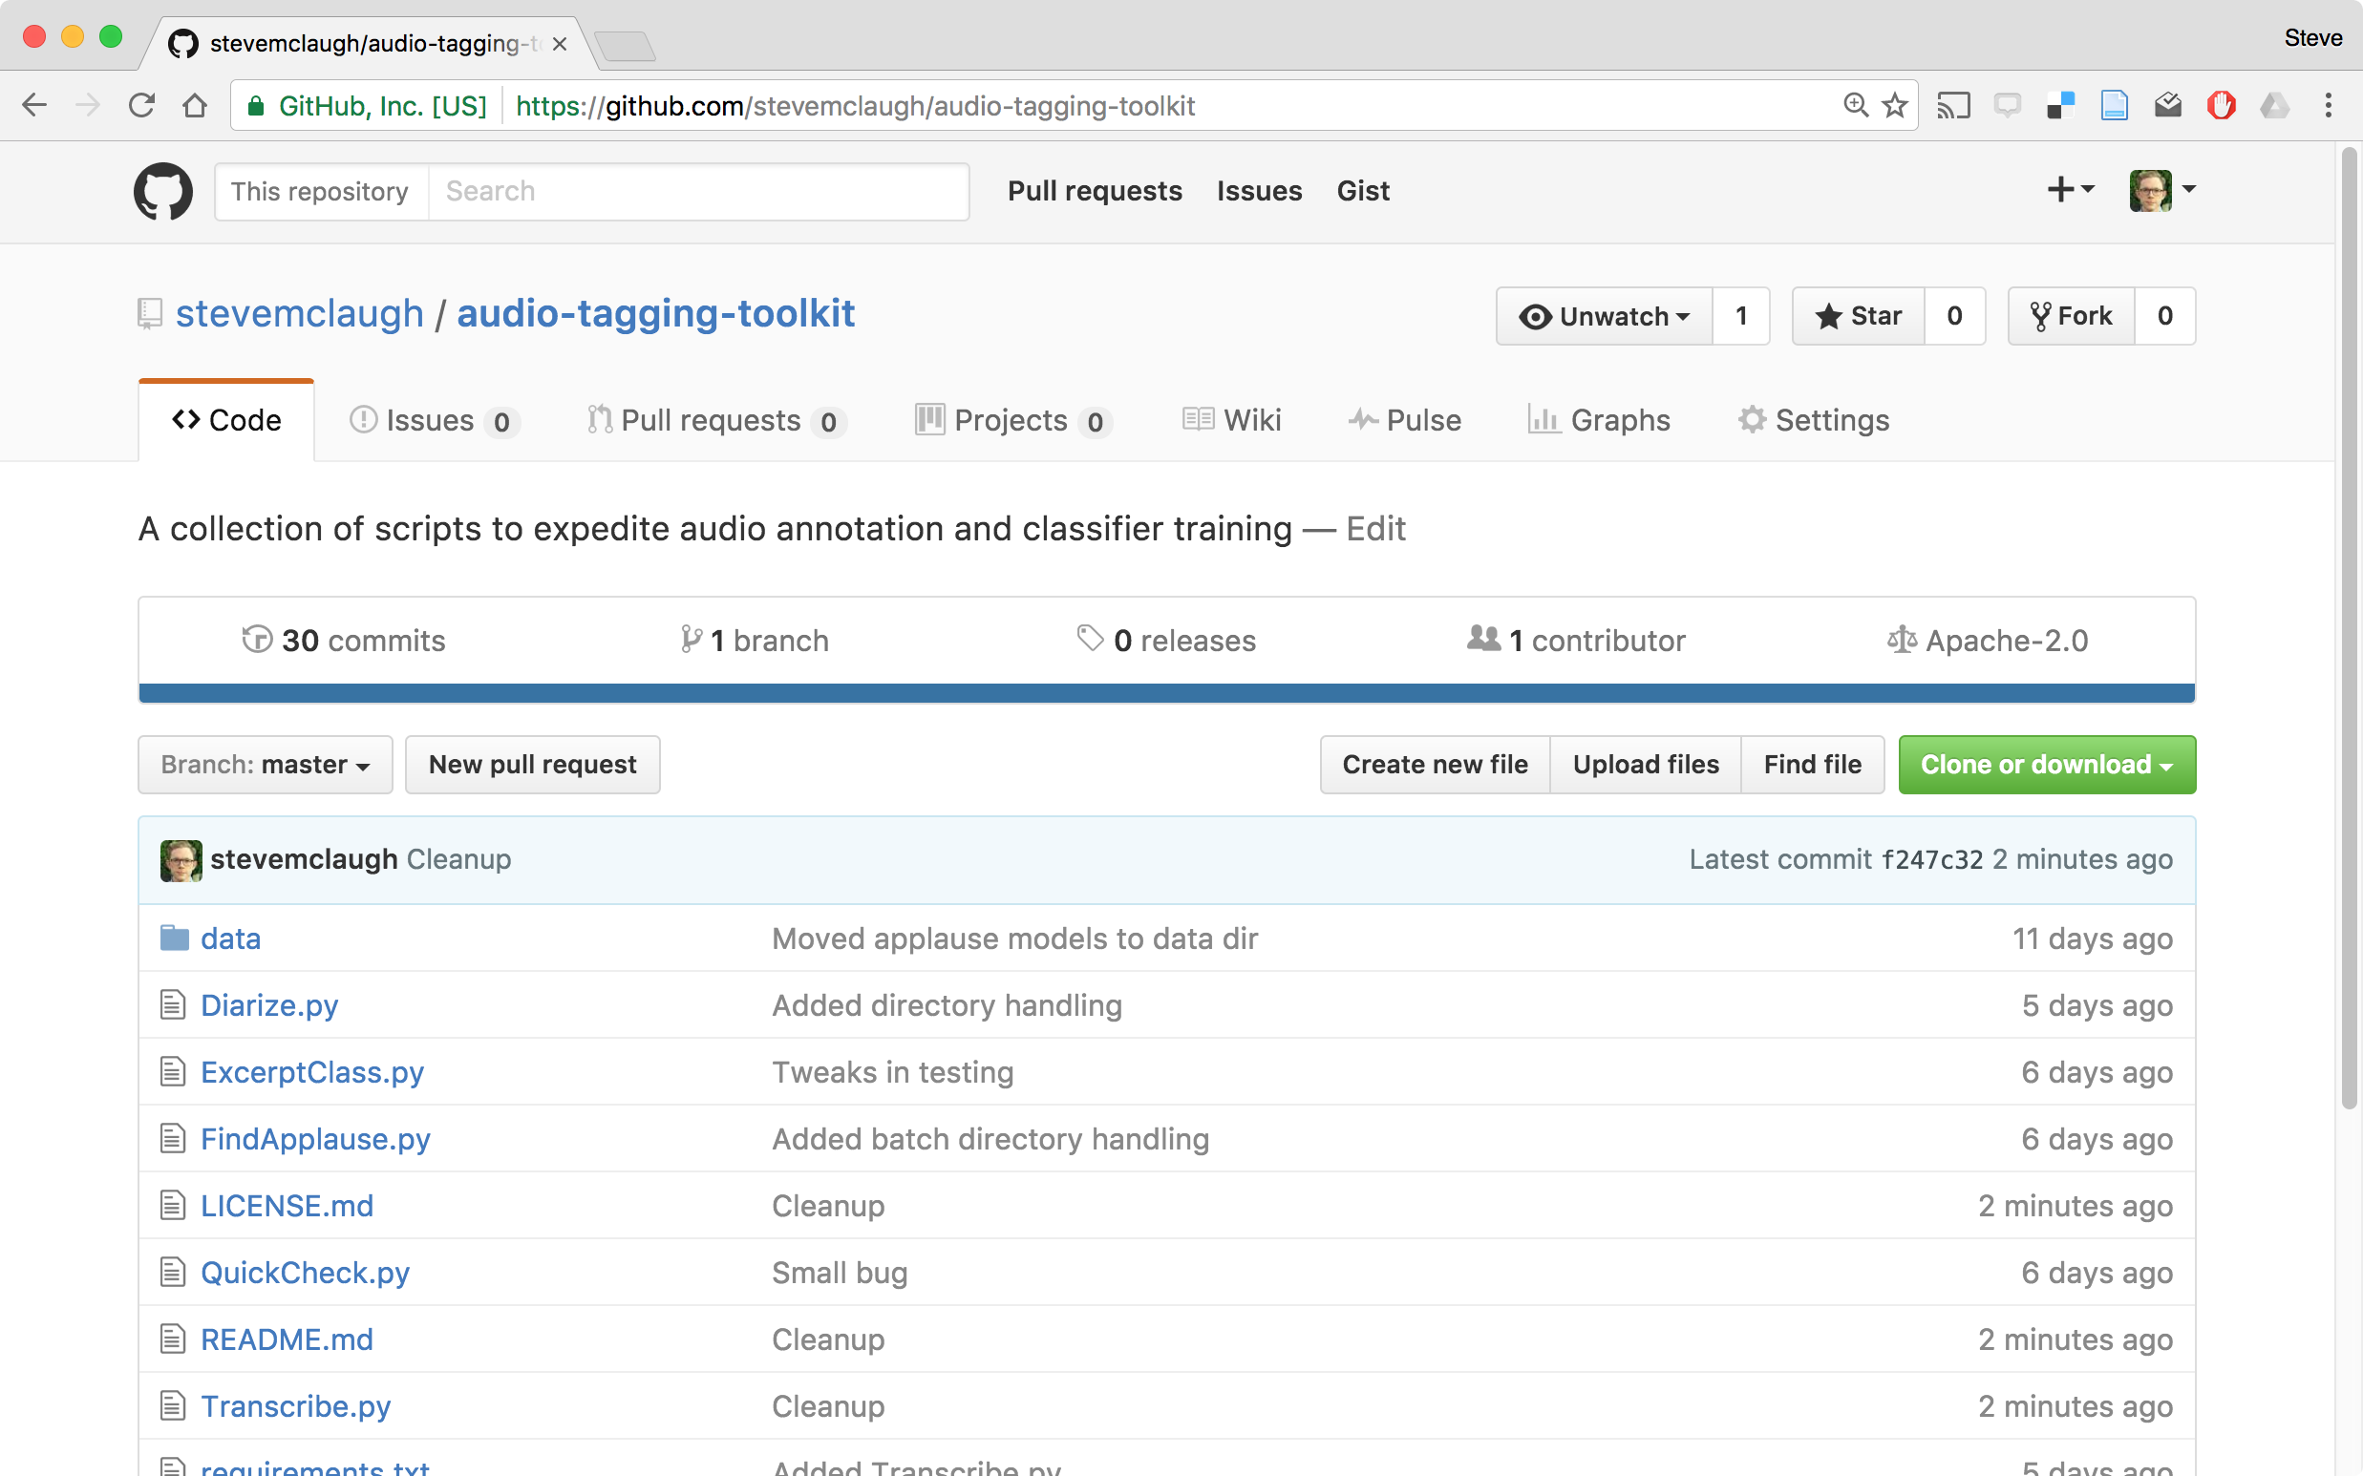
Stephen McLaughlin / @SteveMcLaugh
Notes:
REPLACE

Slide 51



PocketSphinx
Pyperclip
Stephen McLaughlin / @SteveMcLaugh

Slide 52
pyAudioAnalysis
Created and maintained by Theodoros Giannakopoulos
Built on scikit-learn and the SciPy stack
Executes training, classification, silence removal, etc.
Handles dimension reduction and hyperparameter tuning
Simple interface, comprehensible code from pyAudioAnalysis import audioTrainTest as aT aT.featureAndTrain(['Background','Creeley'], 1.0, 1.0, aT.shortTermWindow, aT.shortTermStep, "svm", "svm_creeley", False)
Stephen McLaughlin / @SteveMcLaugh
Notes:
*
If I was bitter or disillusioned about poetry culture, it was perhaps because I hadn’t found my own community.
But eventually I did.
In the years following Issue 1 I got involved in practice.
I submitted videos to Ubuweb.
I did archival work for PennSound and edited the podcast PoemTalk at the Writers House.
I hosted my own poetry interview podcast on Jacket2.org
And I hosted a reading series in Philadelphia from 2011 to 2014, called Principal Hand Presents.
The scene I was a part of — conceptual, post-conceptual — was essentially a complete gift economy.
Giving chapbooks away, sharing PDFs, swapping ideas and links on email threads.
- That became central to my understanding of what it was to write, to make things. Not an alternative to mass culture, but a parallel track where we had some autonomy.

Slide 53
Audio Tagging Toolkit
Find applause in single recording python FindApplause.py -c -b -l "Speaker Name" -i /path/to/audio.mp3
Batch applause classification python FindApplause.py -c -b -l "Speaker Name" path/to/directory/
Batch diarize python Diarize.py -c -b path/to/directory/
Stephen McLaughlin / @SteveMcLaugh
Notes:
*
If I was bitter or disillusioned about poetry culture, it was perhaps because I hadn’t found my own community.
But eventually I did.
In the years following Issue 1 I got involved in practice.
I submitted videos to Ubuweb.
I did archival work for PennSound and edited the podcast PoemTalk at the Writers House.
I hosted my own poetry interview podcast on Jacket2.org
And I hosted a reading series in Philadelphia from 2011 to 2014, called Principal Hand Presents.
The scene I was a part of — conceptual, post-conceptual — was essentially a complete gift economy.
Giving chapbooks away, sharing PDFs, swapping ideas and links on email threads.
- That became central to my understanding of what it was to write, to make things. Not an alternative to mass culture, but a parallel track where we had some autonomy.

Slide 54
Audio Tagging Toolkit
Find applause in single recording python FindApplause.py -c -b -l "Speaker Name" -i /path/to/audio.mp3
Batch applause classification python FindApplause.py -c -b -l "Speaker Name" path/to/directory/
Batch diarize python Diarize.py -c -b path/to/directory/
Stephen McLaughlin / @SteveMcLaugh
Notes:
*
If I was bitter or disillusioned about poetry culture, it was perhaps because I hadn’t found my own community.
But eventually I did.
In the years following Issue 1 I got involved in practice.
I submitted videos to Ubuweb.
I did archival work for PennSound and edited the podcast PoemTalk at the Writers House.
I hosted my own poetry interview podcast on Jacket2.org
And I hosted a reading series in Philadelphia from 2011 to 2014, called Principal Hand Presents.
The scene I was a part of — conceptual, post-conceptual — was essentially a complete gift economy.
Giving chapbooks away, sharing PDFs, swapping ideas and links on email threads.
- That became central to my understanding of what it was to write, to make things. Not an alternative to mass culture, but a parallel track where we had some autonomy.

Slide 55
Audio Tagging Toolkit
Find applause in single recording python FindApplause.py -c -b -l "Speaker Name" -i /path/to/audio.mp3
Batch applause classification python FindApplause.py -c -b -l "Speaker Name" path/to/directory/
Batch diarize python Diarize.py -c -b path/to/directory/
Stephen McLaughlin / @SteveMcLaugh
Notes:
*
If I was bitter or disillusioned about poetry culture, it was perhaps because I hadn’t found my own community.
But eventually I did.
In the years following Issue 1 I got involved in practice.
I submitted videos to Ubuweb.
I did archival work for PennSound and edited the podcast PoemTalk at the Writers House.
I hosted my own poetry interview podcast on Jacket2.org
And I hosted a reading series in Philadelphia from 2011 to 2014, called Principal Hand Presents.
The scene I was a part of — conceptual, post-conceptual — was essentially a complete gift economy.
Giving chapbooks away, sharing PDFs, swapping ideas and links on email threads.
- That became central to my understanding of what it was to write, to make things. Not an alternative to mass culture, but a parallel track where we had some autonomy.

Slide 56
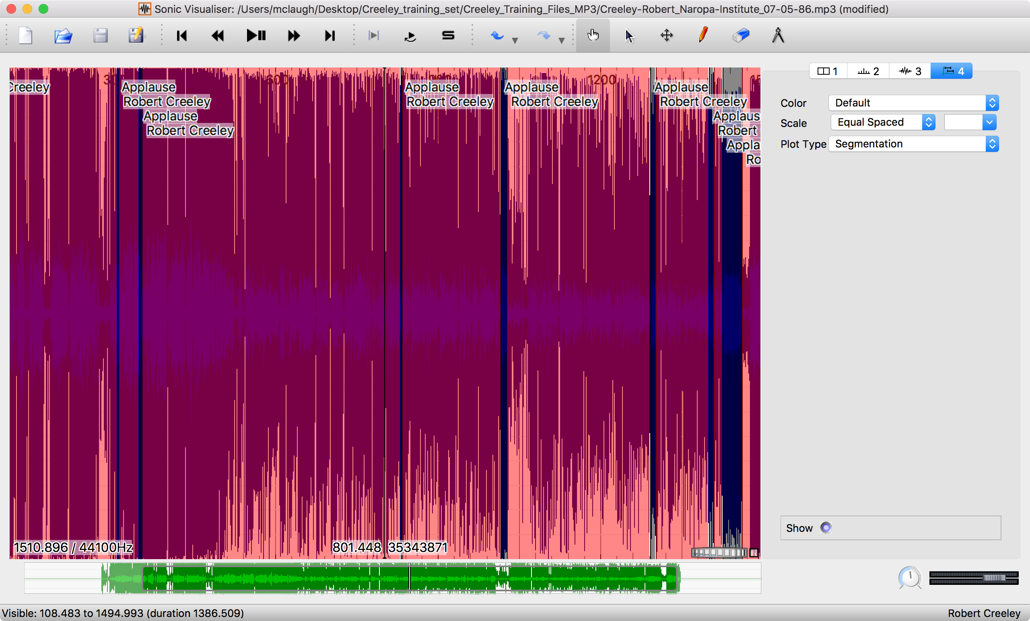
Stephen McLaughlin / @SteveMcLaugh
Notes:
Developed at the Centre for Digital Music, Queen Mary, University of London.
Alternatives: PRAAT, ANVIL, Transcriber

Slide 57
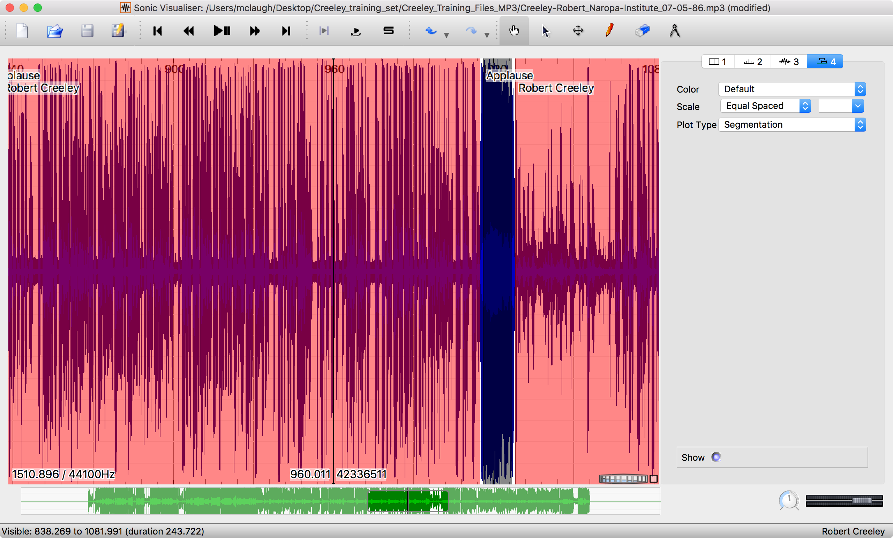
Stephen McLaughlin / @SteveMcLaugh

Slide 58
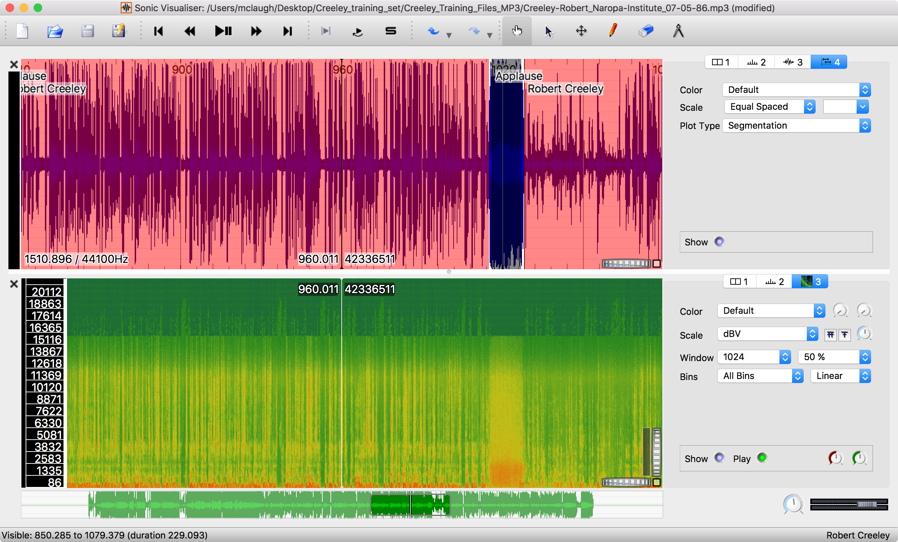
Stephen McLaughlin / @SteveMcLaugh
Notes:
Creeley: 340 files
140 corrected by hand to get 15 hours
10 hours of PennSound UBM

Slide 59
Stephen McLaughlin / @SteveMcLaugh
Notes:
Creeley-Robert_01_Complete-Reading_92nd-St-Y_NYC_1986.mp3 demo –
2 applauses at beginning separate intro and reading(?) by someone else - example of quickly finding transition that would otherwise be time-consuming to locate
Intro by Shelley(sp) Mason, director of the poetry center
Gwendolyn Brooks & Creeley, both introduced by DH Mellom

Slide 60
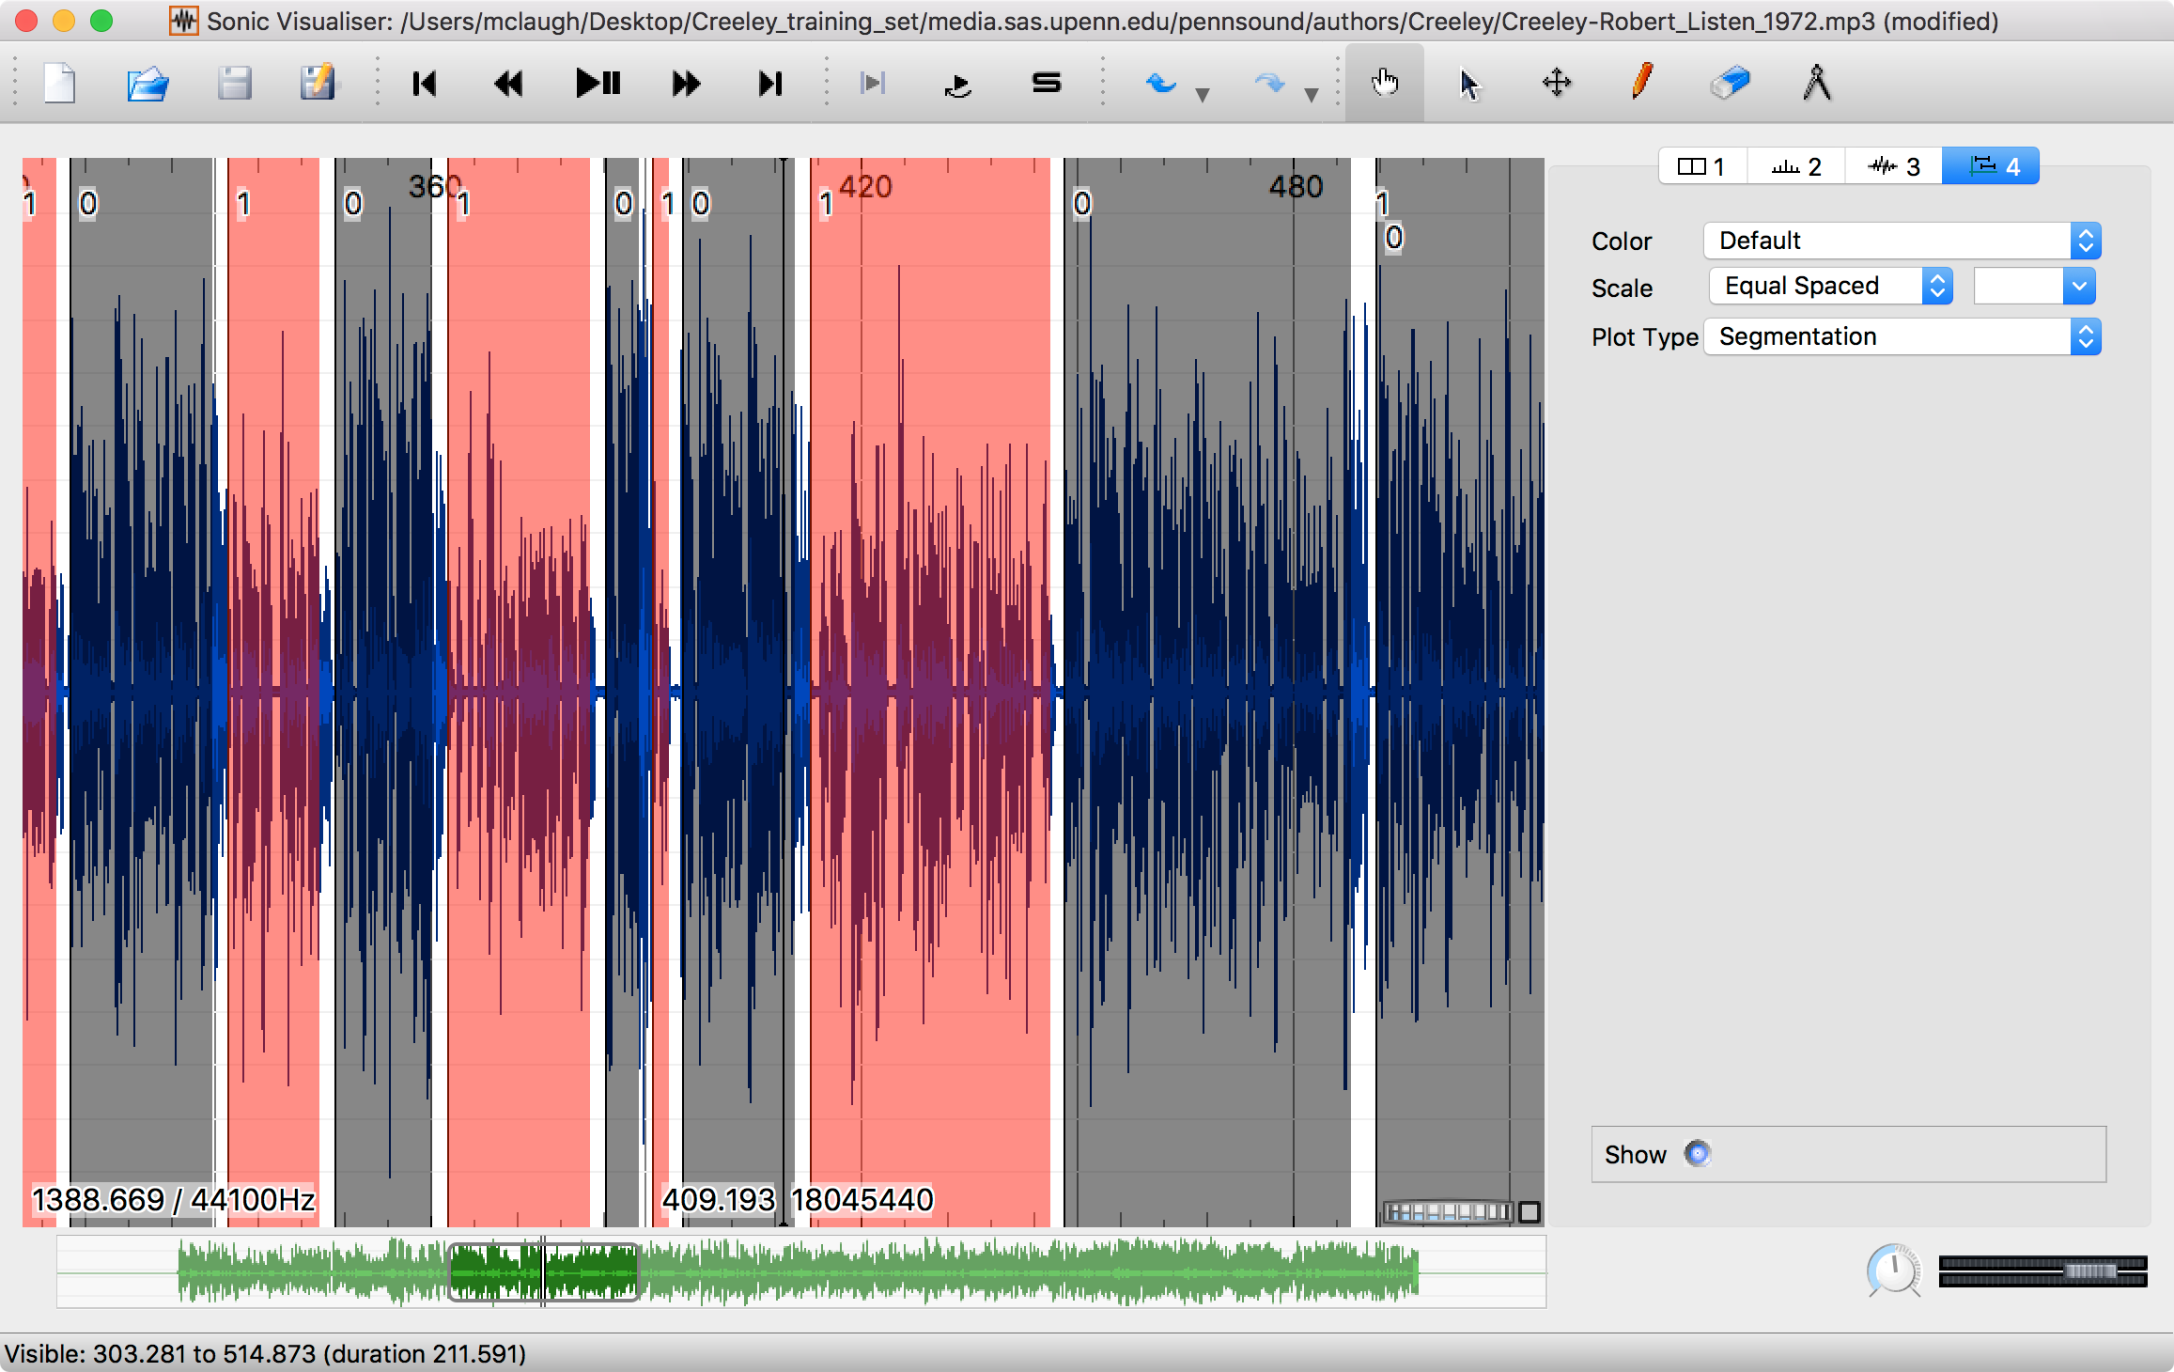
Stephen McLaughlin / @SteveMcLaugh

Slide 61
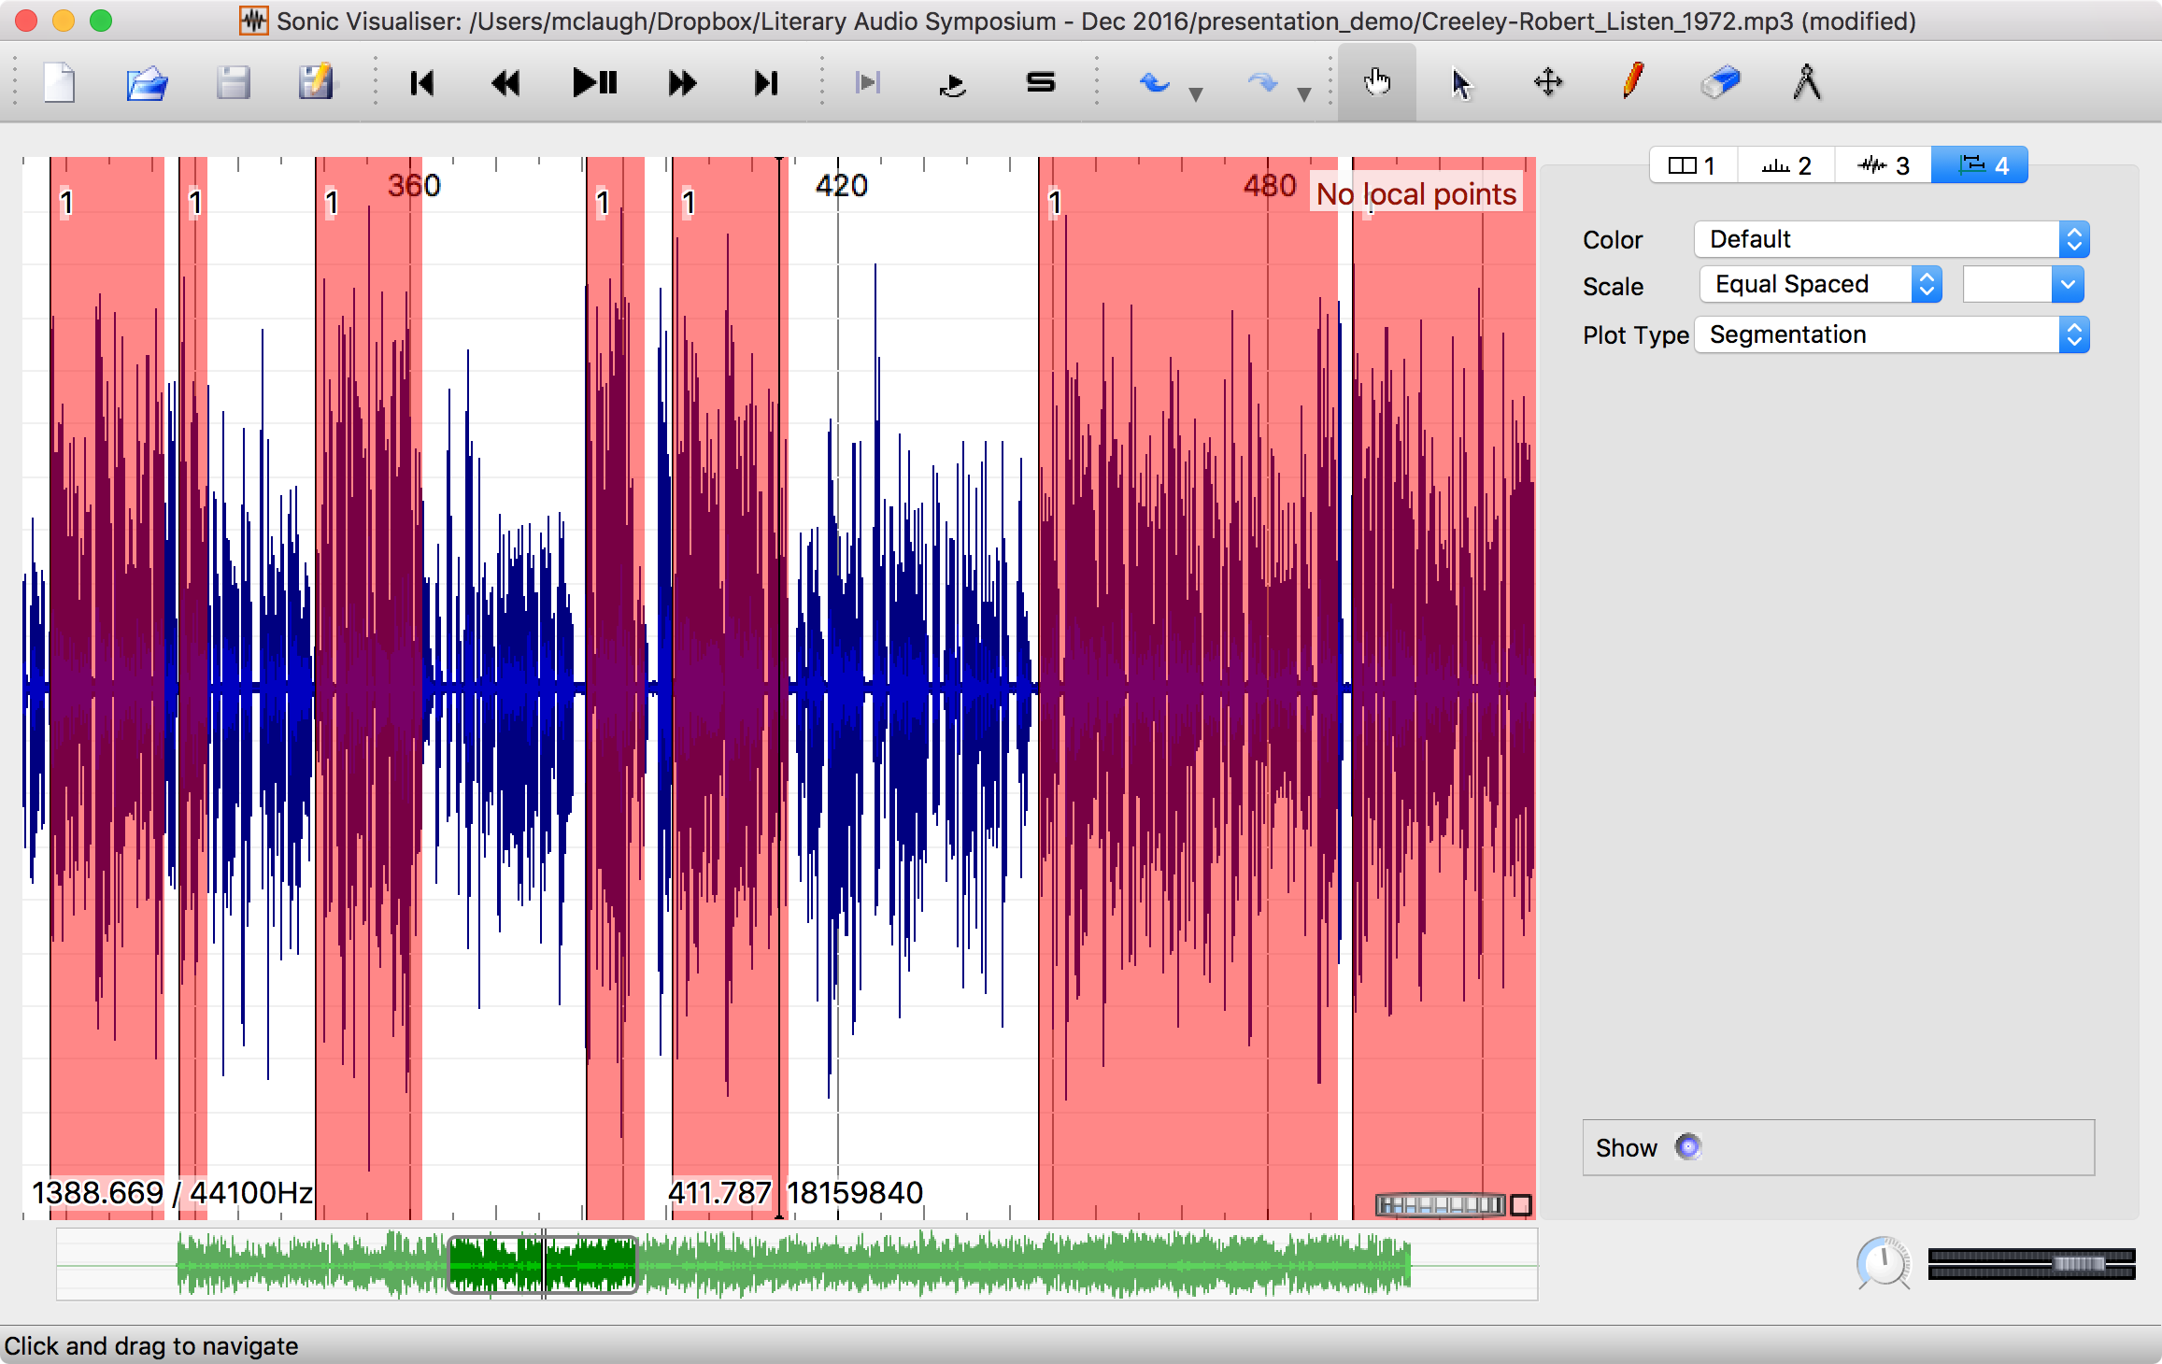
Stephen McLaughlin / @SteveMcLaugh

Slide 62

⟶
applause detection and/or diarization
⟶
manual validation
⟶
speaker recognition
⟶
manual validation
⟶
annotated corpus
⟶
retrieval, segmentation, new ML training, etc.
Stephen McLaughlin / @SteveMcLaugh
Notes:
*
If I was bitter or disillusioned about poetry culture, it was perhaps because I hadn’t found my own community.
But eventually I did.
In the years following Issue 1 I got involved in practice.
I submitted videos to Ubuweb.
I did archival work for PennSound and edited the podcast PoemTalk at the Writers House.
I hosted my own poetry interview podcast on Jacket2.org
And I hosted a reading series in Philadelphia from 2011 to 2014, called Principal Hand Presents.
The scene I was a part of — conceptual, post-conceptual — was essentially a complete gift economy.
Giving chapbooks away, sharing PDFs, swapping ideas and links on email threads.
- That became central to my understanding of what it was to write, to make things. Not an alternative to mass culture, but a parallel track where we had some autonomy.

Slide 63
Stephen McLaughlin / @SteveMcLaugh
Notes:
REPLACE

Slide 64
Stephen McLaughlin / @SteveMcLaugh
Notes:
This is not an option.

Slide 65
Bottlenecks to wide application
Compute time
Stephen McLaughlin / @SteveMcLaugh

Slide 66
Bottlenecks to wide application
Compute time
Existing metadata quality
Stephen McLaughlin / @SteveMcLaugh

Slide 67
Bottlenecks to wide application
Compute time
Existing metadata quality
Human ML training time
Stephen McLaughlin / @SteveMcLaugh

Slide 68
Bottlenecks to wide application
Compute time
Existing metadata quality
Human ML training time
Technical literacy
Stephen McLaughlin / @SteveMcLaugh

Slide 69
Bottlenecks to wide application
Compute time
Existing metadata quality
Human ML training time
Technical literacy
Copyright restrictions
Stephen McLaughlin / @SteveMcLaugh

Slide 70
Humanists are patient.
Stephen McLaughlin / @SteveMcLaugh
Notes:
Digging through archives is hard, and it’s maddening — and it’s fun! But it can also be brutally boring, and that’s the work that humanists do: literary studies, material history, regular history ... it’s a slog.
I’m kinda glad I only have one foot in literary studies,.
Keep being patient, people.

Slide 71
Meaningful search ⟶ Long-term preservation
Stephen McLaughlin / @SteveMcLaugh
Notes:
If this isn’t out of school — PennSound has things they don’t post for the public ... but in principle they *could* make that material searchable in some form.
I’d love if one of you want to push this far enough to get sued ... though the supreme court does change from time to time

Slide 72
Title
1
2
3
4
Stephen McLaughlin / @SteveMcLaugh

Slide 73
Stephen McLaughlin / @SteveMcLaugh
Notes:
This is not an option.

Slide 74
Title
1
2
3
4
Stephen McLaughlin / @SteveMcLaugh

Slide 75
Stephen McLaughlin / @SteveMcLaugh
Notes:
This is not an option.

Slide 76
Title
1
2
3
4
Stephen McLaughlin / @SteveMcLaugh

Slide 77
Stephen McLaughlin / @SteveMcLaugh
Notes:
This is not an option.

Slide 78
Title
1
2
3
4
Stephen McLaughlin / @SteveMcLaugh

Slide 79
Stephen McLaughlin / @SteveMcLaugh
Notes:
This is not an option.

Slide 80
Title
1
2
3
4
Stephen McLaughlin / @SteveMcLaugh

Slide 81
Stephen McLaughlin / @SteveMcLaugh
Notes:
This is not an option.

Slide 82
Title
1
2
3
4
Stephen McLaughlin / @SteveMcLaugh

Slide 83
Stephen McLaughlin / @SteveMcLaugh
Notes:
This is not an option.

Slide 84
Title
1
2
3
4
Stephen McLaughlin / @SteveMcLaugh

Slide 85
Stephen McLaughlin / @SteveMcLaugh
Notes:
This is not an option.

Slide 86
Title
1
2
3
4
Stephen McLaughlin / @SteveMcLaugh

Slide 87
Stephen McLaughlin / @SteveMcLaugh
Notes:
This is not an option.

Slide 88
Title
1
2
3
4
Stephen McLaughlin / @SteveMcLaugh

Slide 89
Stephen McLaughlin / @SteveMcLaugh
Notes:
This is not an option.

Slide 90
Title
1
2
3
4
Stephen McLaughlin / @SteveMcLaugh

Slide 91
Stephen McLaughlin / @SteveMcLaugh
Notes:
This is not an option.

Slide 92
Title
1
2
3
4
Stephen McLaughlin / @SteveMcLaugh

Slide 93
Stephen McLaughlin / @SteveMcLaugh
Notes:
This is not an option.

Slide 94
Title
1
2
3
4
Stephen McLaughlin / @SteveMcLaugh

Slide 95
Stephen McLaughlin / @SteveMcLaugh
Notes:
This is not an option.

Slide 96
Title
1
2
3
4
Stephen McLaughlin / @SteveMcLaugh

Slide 97
Stephen McLaughlin / @SteveMcLaugh
Notes:
This is not an option.

Slide 98
Title
1
2
3
4
Stephen McLaughlin / @SteveMcLaugh

Slide 99
Stephen McLaughlin / @SteveMcLaugh
Notes:
This is not an option.

Slide 100
Title
1
2
3
4
Stephen McLaughlin / @SteveMcLaugh

